Slide 1
Analysis of metabolomics, methylation and transcriptomic of Breast cancer
Fadhl Alakwaa
https://github.com/FADHLyemen/Metabolomics_signature
https://pubs.acs.org/doi/abs/10.1021/acs.jproteome.9b00755

Slide 2
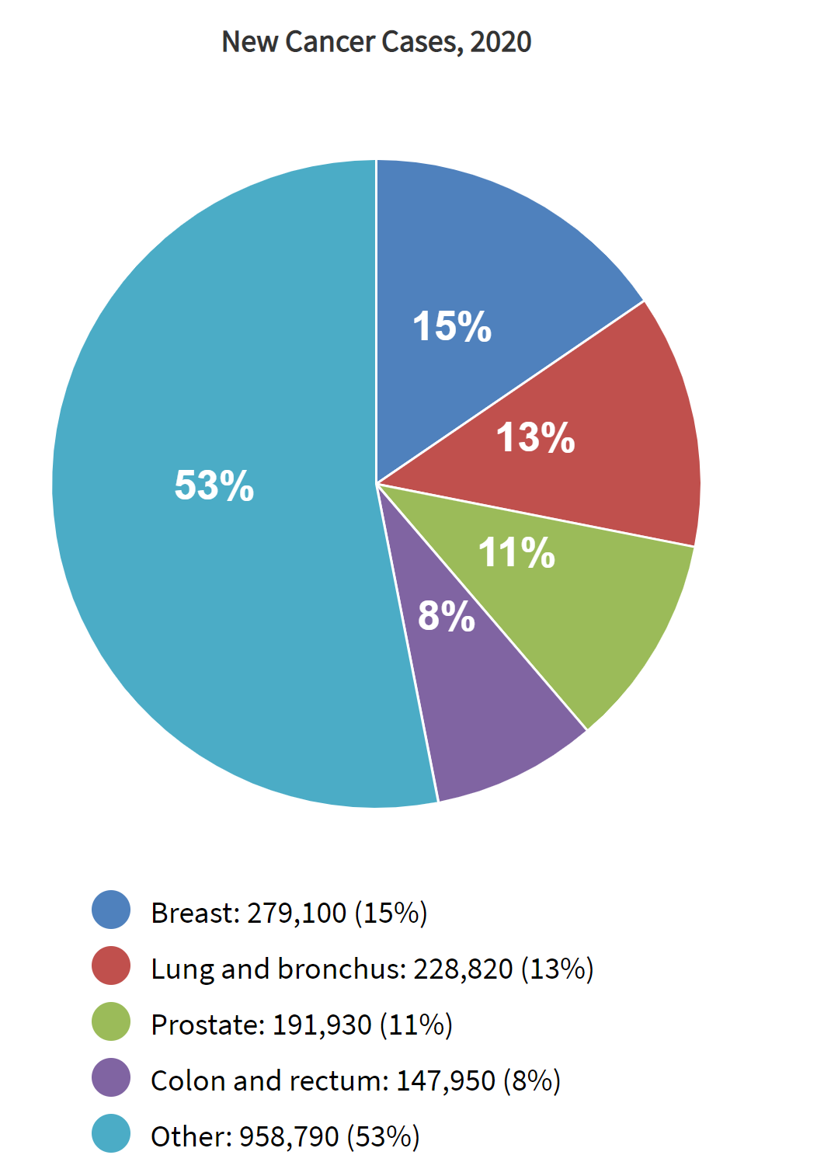
https://seer.cancer.gov/statfacts/html/common.html

Slide 3
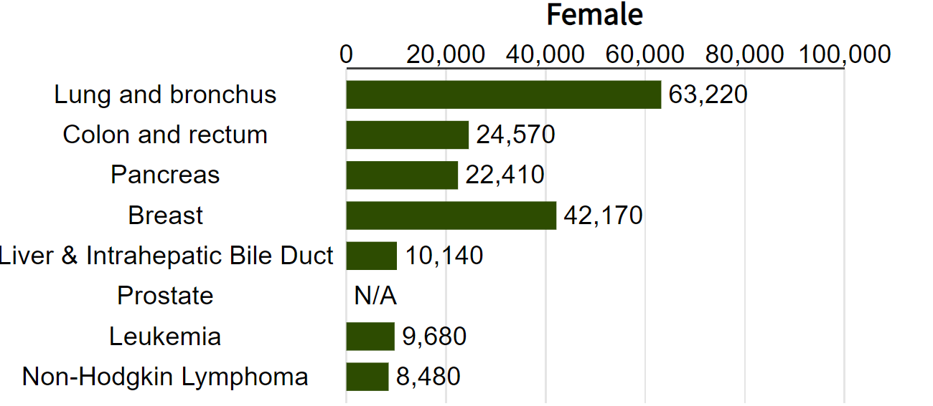
Breast cancer mortality rate (2020)
https://seer.cancer.gov/statfacts/html/common.html
Notes:
Breast cancer (BC) is the second most common cancer mortality in women in the United States.

Slide 4
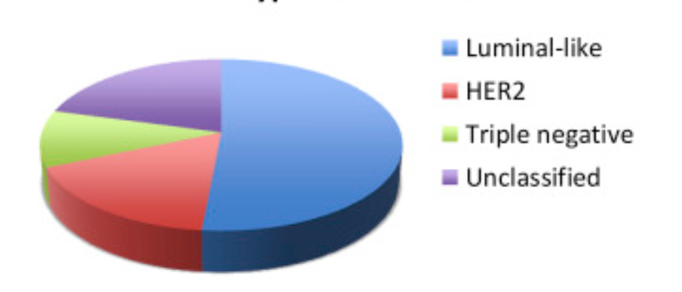
Breast cancer subtypes
Subtyping based on transcriptomic omics data.
Treatment based on subtyping.
Could we use other omics data for subtyping?
Non-invasive and cheaper.

Slide 5
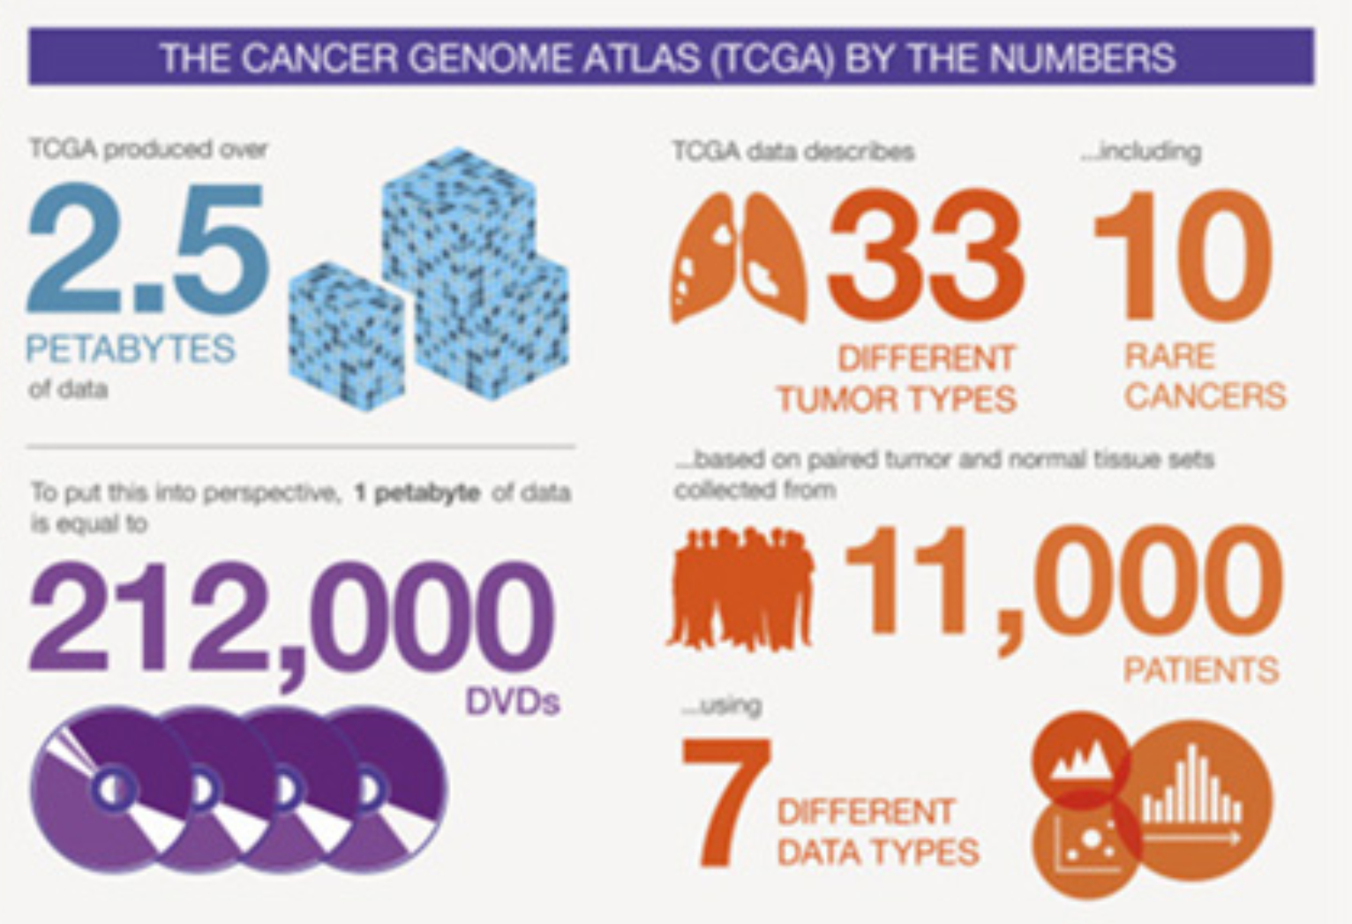
The Cancer Genome Atlas Program (TCGA)

Slide 6
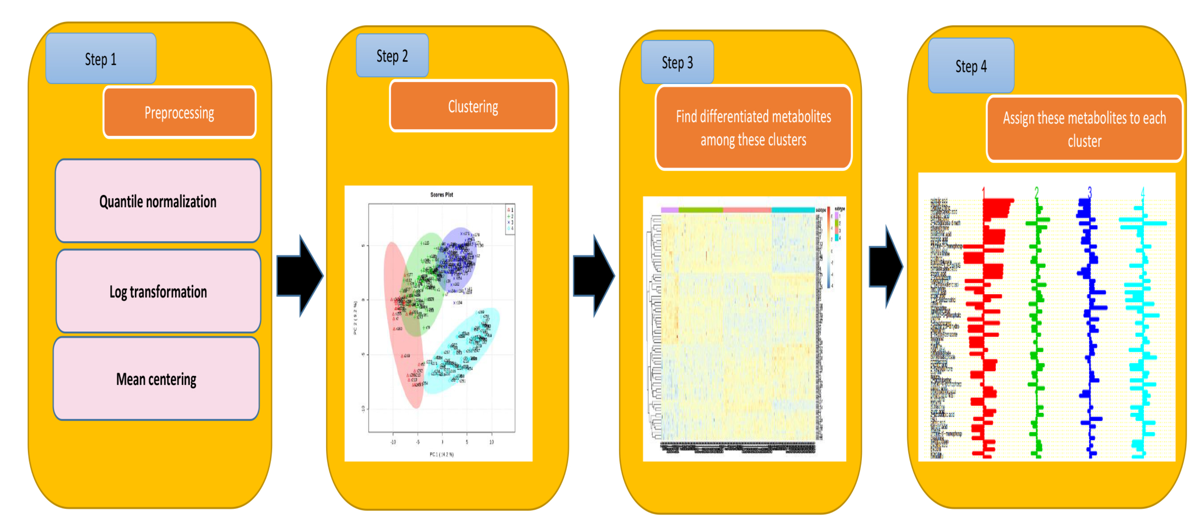
Pipeline
Tools: K-means, SAM, PAM
https://github.com/FADHLyemen/Metabolomics_signature

Slide 7
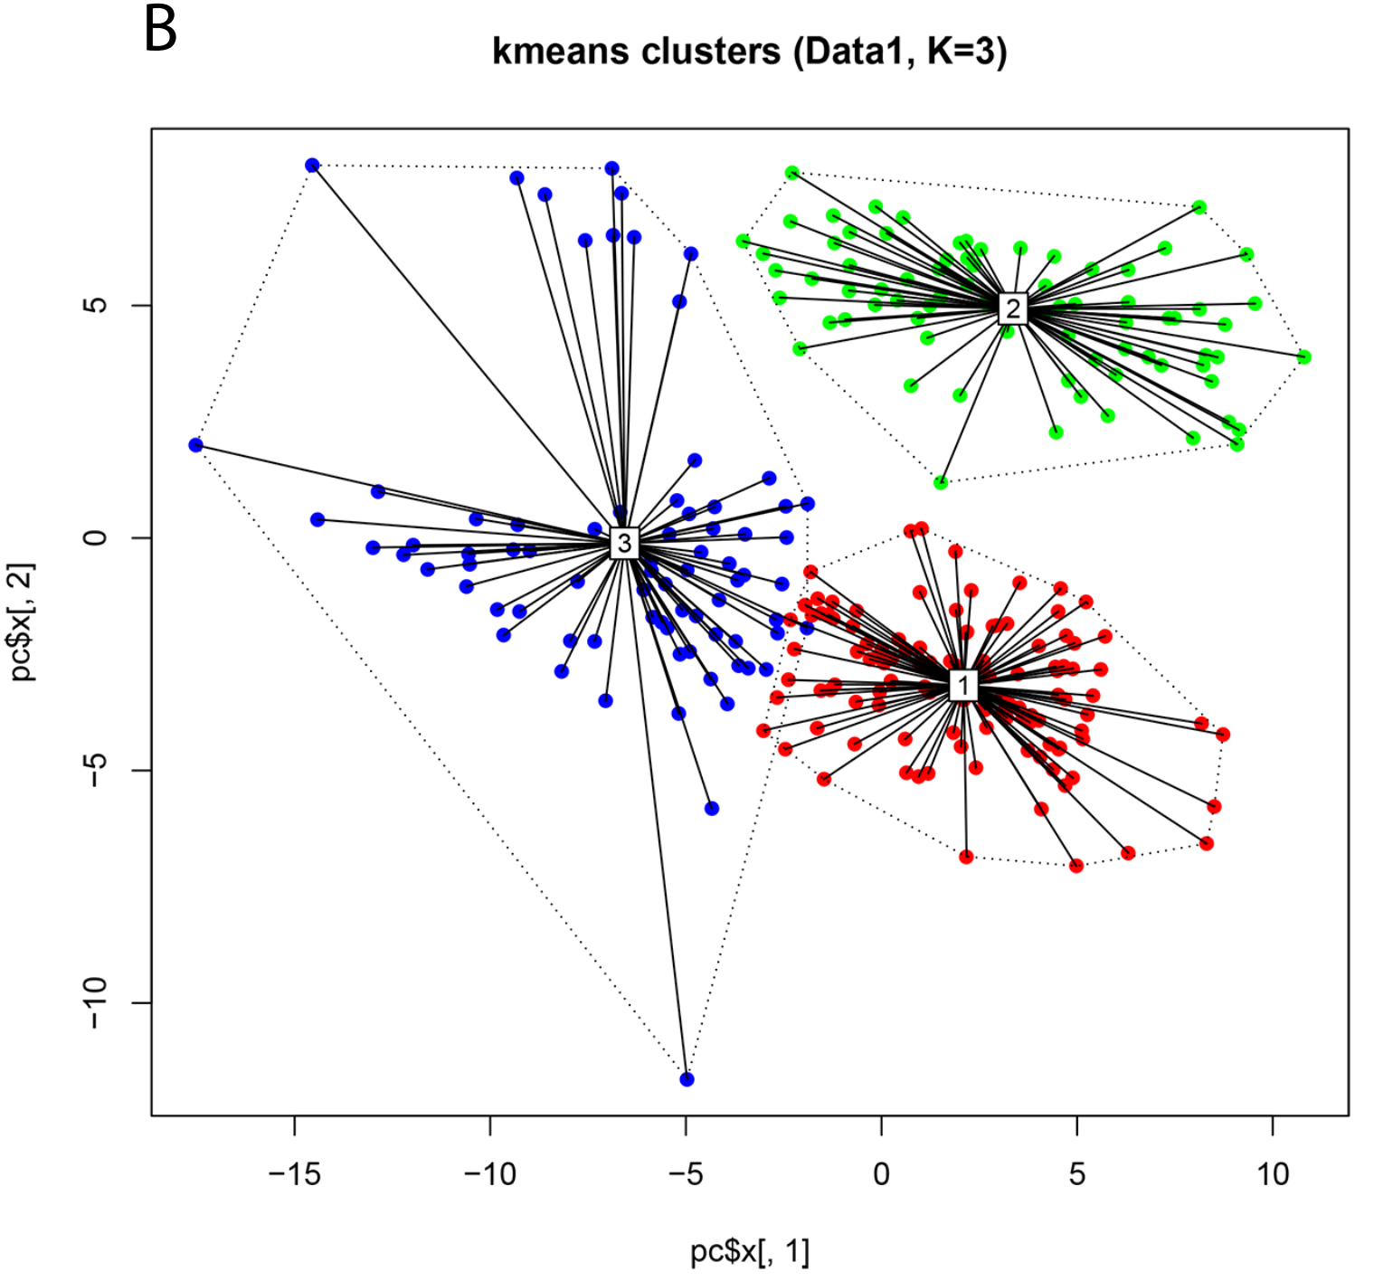
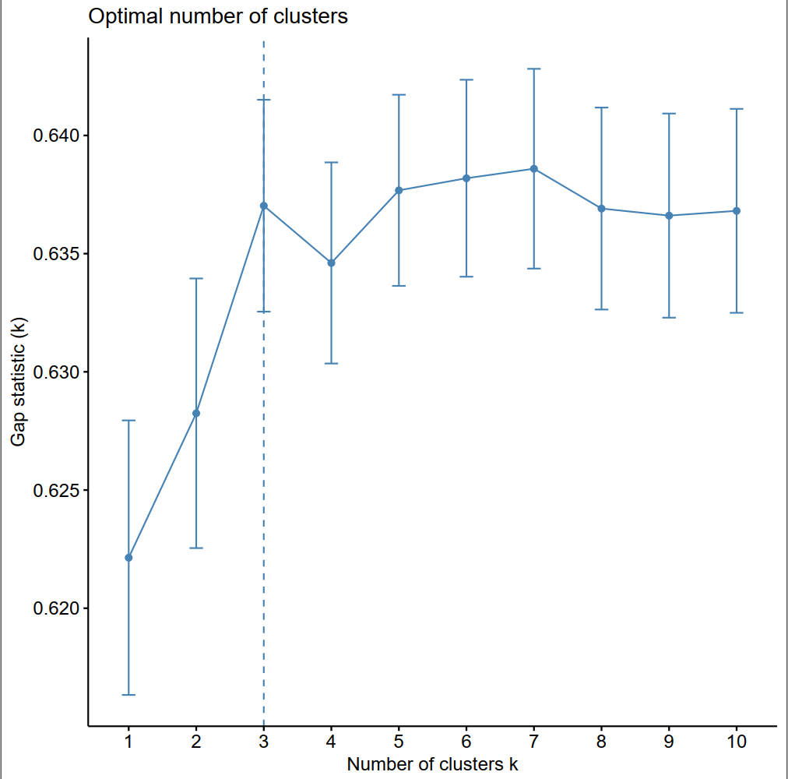

Slide 8
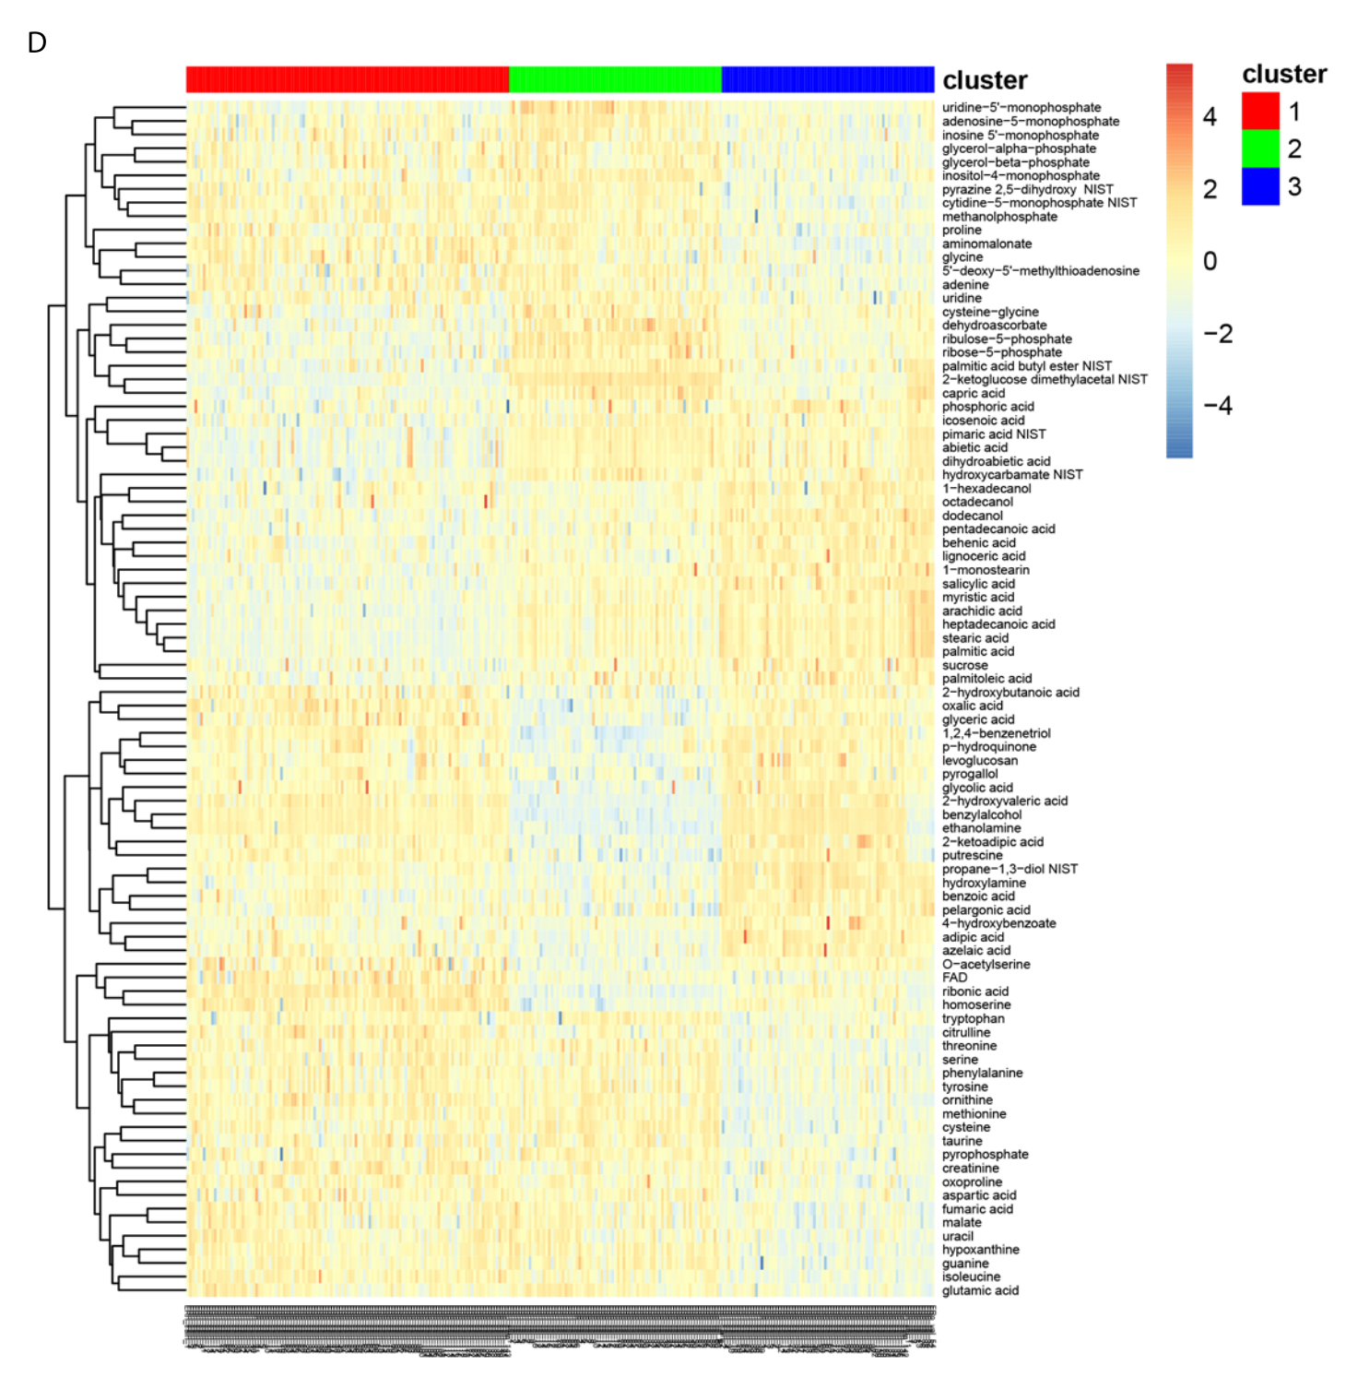

Slide 9
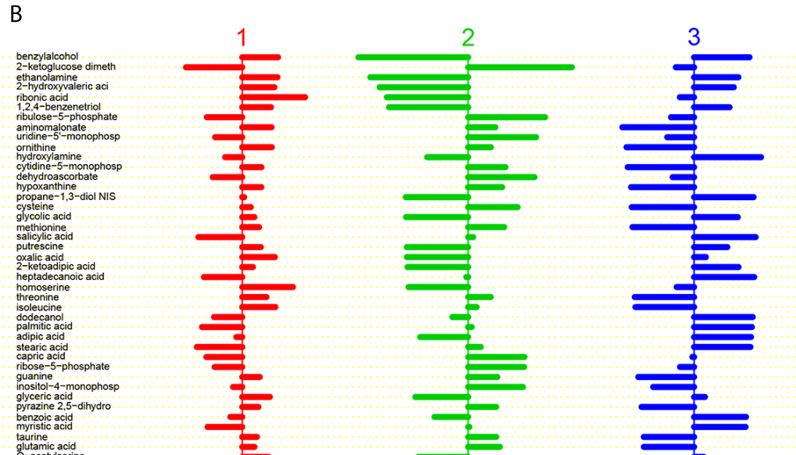

Slide 10
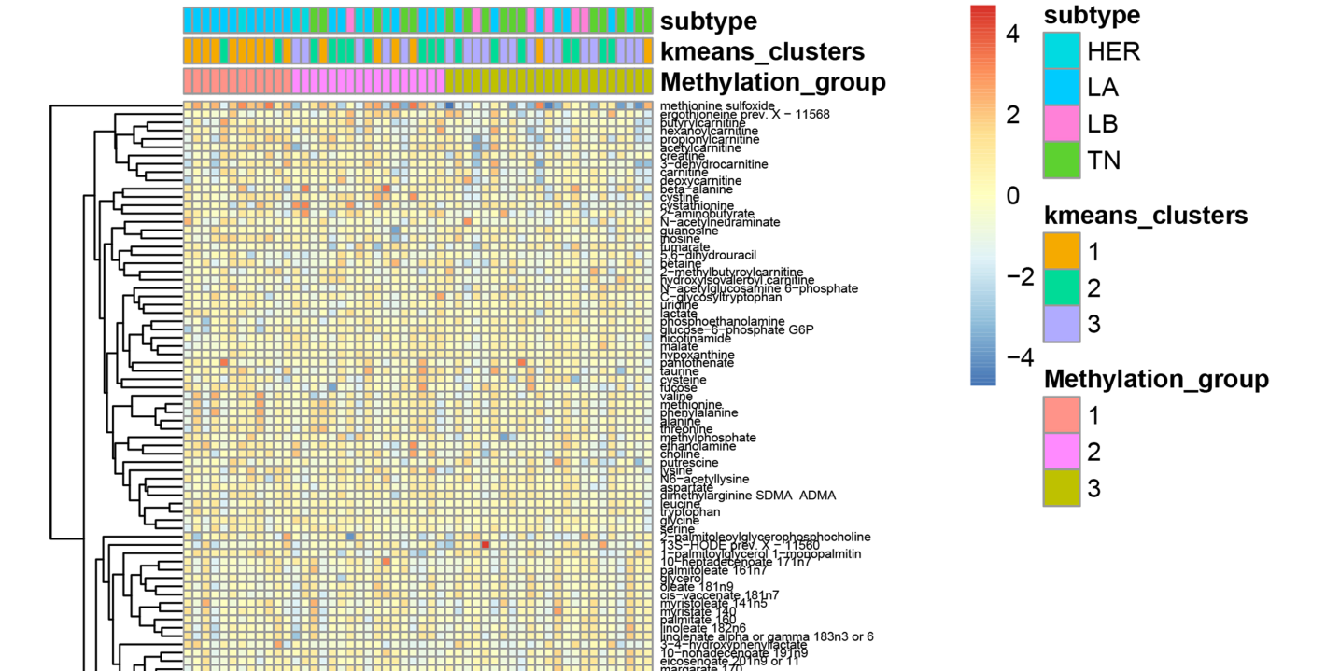

Slide 11
Conclusion
Generally, metabolome-defined BC subtypes were different from the well-known receptor- or transcriptome-defined subtypes.
We identified a strong association BC clusters identified from metabolomics and methylation data.
Our proposed pipeline revealed clusters characterized by unique metabolic signatures that may potentially stratify BC patients and tailor precision treatment.

Slide 13
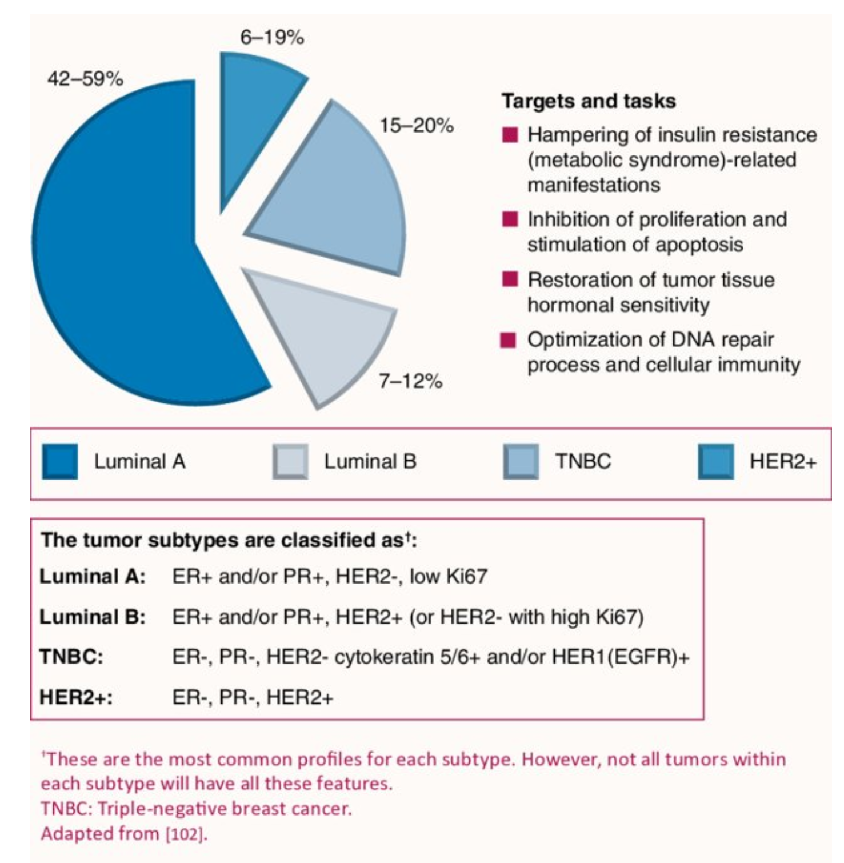
Notes:
https://www.researchgate.net/publication/262379091_Role_of_metabolic_rehabilitation-based_approach_in_TNBC_Biguanide_metformin_and_more/figures?lo=1

